Slide 1
Simulated Annealing
Van Laarhoven, Aarts
Version 1, October 2000

Slide 2
Iterative Improvement 1
General method to solve combinatorial optimization problems
Principle:
Start with initial configuration
Repeatedly search neighborhood and select a neighbor as candidate
Evaluate some cost function (or fitness function) and accept candidate if "better"; if not, select another neighbor
Stop if quality is sufficiently high, if no improvement can be found or after some fixed time

Slide 3
Iterative Improvement 2
Needed are:
A method to generate initial configuration
A transition or generation function to find a neighbor as next candidate
A cost function
An Evaluation Criterion
A Stop Criterion

Slide 4
Iterative Improvement 3
Simple Iterative Improvement or Hill Climbing:
Candidate is always and only accepted if cost is lower (or fitness is higher) than current configuration
Stop when no neighbor with lower cost (higher fitness) can be found
Disadvantages:
Local optimum as best result
Local optimum depends on initial configuration
Generally no upper bound on iteration length

Slide 5
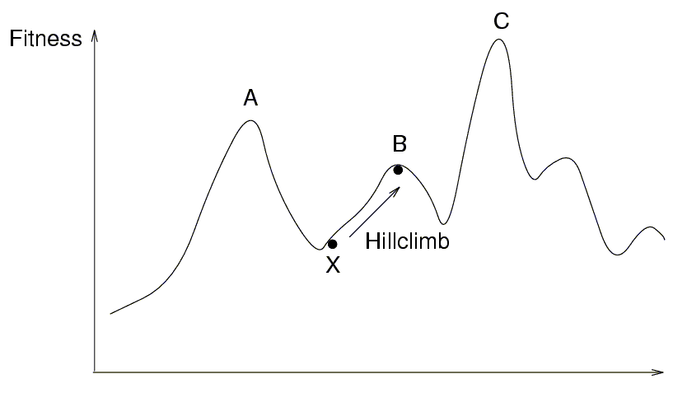
Hill climbing

Slide 6
How to cope with disadvantages
Repeat algorithm many times with different initial configurations
Use information gathered in previous runs
Use a more complex Generation Function to jump out of local optimum
Use a more complex Evaluation Criterion that accepts sometimes (randomly) also solutions away from the (local) optimum

Slide 7
Simulated Annealing
Use a more complex Evaluation Function:
Do sometimes accept candidates with higher cost to escape from local optimum
Adapt the parameters of this Evaluation Function during execution
Based upon the analogy with the simulation of the annealing of solids

Slide 8
Other Names
Monte Carlo Annealing
Statistical Cooling
Probabilistic Hill Climbing
Stochastic Relaxation
Probabilistic Exchange Algorithm

Slide 9
Analogy
Slowly cool down a heated solid, so that all particles arrange in the ground energy state
At each temperature wait until the solid reaches its thermal equilibrium
Probability of being in a state with energy E :
Pr { E = E } = 1/Z(T) . exp (-E / k_{B}.T)
E Energy
T Temperature
k_{B} Boltzmann constant
Z(T) Normalization factor (temperature dependant)

Slide 10
Simulation of cooling (Metropolis 1953)
At a fixed temperature T :
Perturb (randomly) the current state to a new state
ΔE is the difference in energy between current and new state
If ΔE < 0 (new state is lower), accept new state as current state
If ΔE ≥ 0 , accept new state with probability
Pr (accepted) = exp (- ΔE / k_{B}.T)
Eventually the systems evolves into thermal equilibrium at temperature T ; then the formula mentioned before holds
When equilibrium is reached, temperature T can be lowered and the process can be repeated

Slide 11
Simulated Annealing
Same algorithm can be used for combinatorial optimization problems:
Energy E corresponds to the Cost function C
Temperature T corresponds to control parameter c
Pr { configuration = i } = 1/Q(c) . exp (-C(i) / c)
C Cost
c Control parameter
Q(c) Normalization factor (not important)

Slide 12
Homogeneous Algorithm
initialize;
REPEAT
REPEAT
perturb ( config.i → config.j, ΔC_{ij});
IF ΔC_{ij} < 0 THEN accept
ELSE IF exp(-ΔC_{ij}/c) > random[0,1) THEN accept;
IF accept THEN update(config.j);
UNTIL equilibrium is approached sufficient closely;
c := next_lower(c);
UNTIL system is frozen or stop criterion is reached

Slide 13
Inhomogeneous Algorithm
Previous algorithm is the homogeneous variant:
c is kept constant in the inner loop and is only decreased in the outer loop
Alternative is the inhomogeneous variant:
There is only one loop; c is decreased each time in the loop, but only very slightly

Slide 14
Parameters
Choose the start value of c so that in the beginning nearly all perturbations are accepted (exploration), but not too big to avoid long run times
The function next_lower in the homogeneous variant is generally a simple function to decrease c, e.g. a fixed part (80%) of current c
At the end c is so small that only a very small number of the perturbations is accepted (exploitation)
If possible, always try to remember explicitly the best solution found so far; the algorithm itself can leave its best solution and not find it again

Slide 15
Markov Chains 1
Markov Chain:
Sequence of trials where the outcome of each trial depends only on the outcome of the previous one
Markov Chain is a set of conditional probabilities:
P_{ij} (k-1,k)
Probability that the outcome of the k-th trial is j, when trial k-1 is i
Markov Chain is homogeneous when the probabilities do not depend on k

Slide 16
Markov Chains 2
When c is kept constant (homogeneous variant), the probabilities do not depend on k and for each c there is one homogeneous Markov Chain
When c is not constant (inhomogeneous variant), the probabilities do depend on k and there is one inhomogeneous Markov Chain

Slide 17
Performance
SA is a general solution method that is easily applicable to a large number of problems
"Tuning" of the parameters (initial c, decrement of c, stop criterion) is relatively easy
Generally the quality of the results of SA is good, although it can take a lot of time
Results are generally not reproducible: another run can give a different result
SA can leave an optimal solution and not find it again
(so try to remember the best solution found so far)
Proven to find the optimum under certain conditions; one of these conditions is that you must run forever

